Slide 1
Final Project Online Shopping System
Afifa Nowreen Akhter
UG02-47-18-023

Slide 2
Introduction
An Online Shopping System which will allow formal and informal merchants in developing countries to advertise and sell their goods on the internet. This would permit rural communities to make their wares available to the rest of the world via world wide web.

Slide 3
Abstract
The objective of the project is to create an Online Shopping System web portal with a content management system which would allow product information to be updated securely using a mobile device. The web portal will have an online interface in the form of an Online Shopping System website that will allow users to buy goods from the merchants.

Slide 4
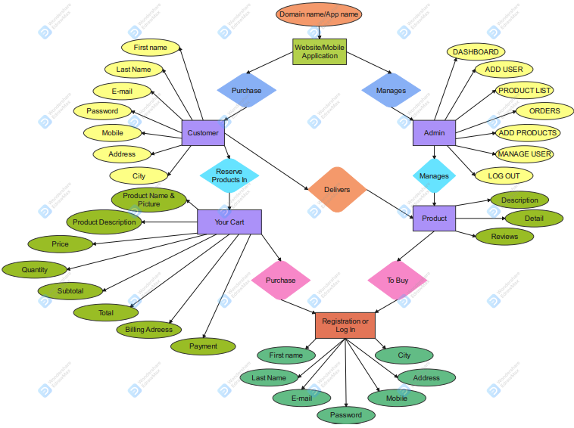
ER Diagram

Slide 5
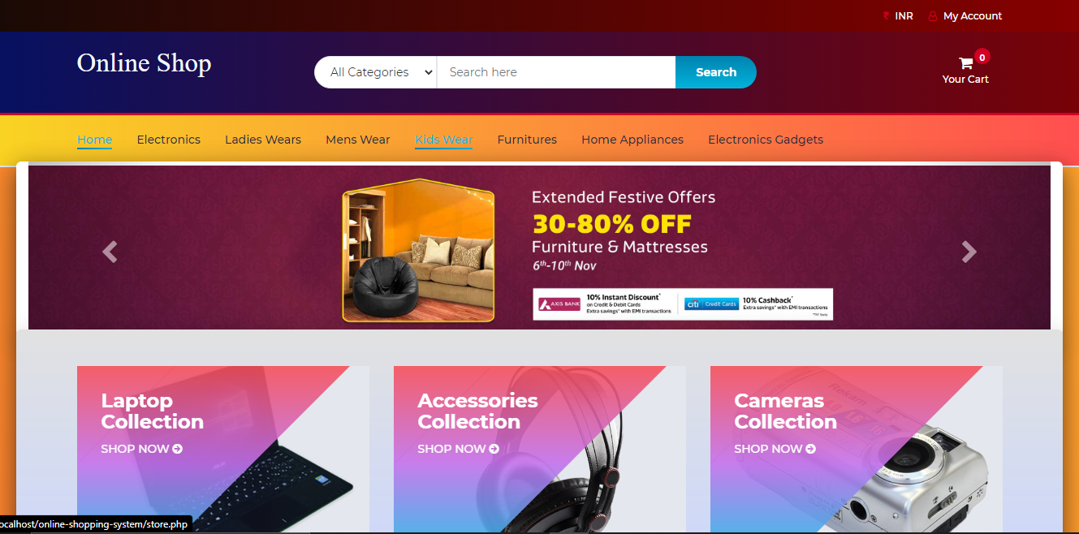
Home Page

Slide 6
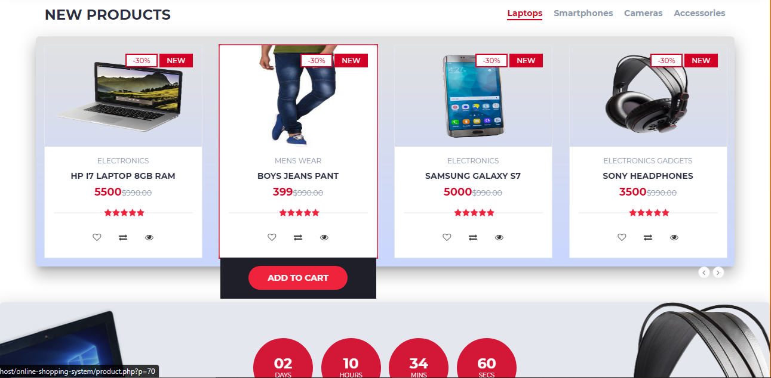
Home Page

Slide 7
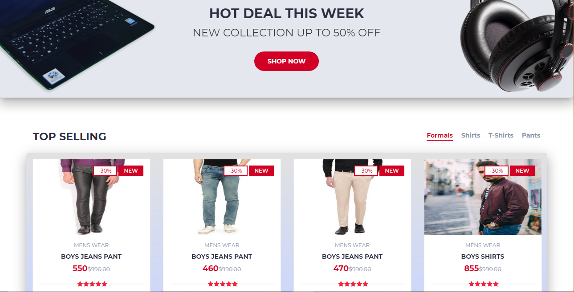
Home Page

Slide 8
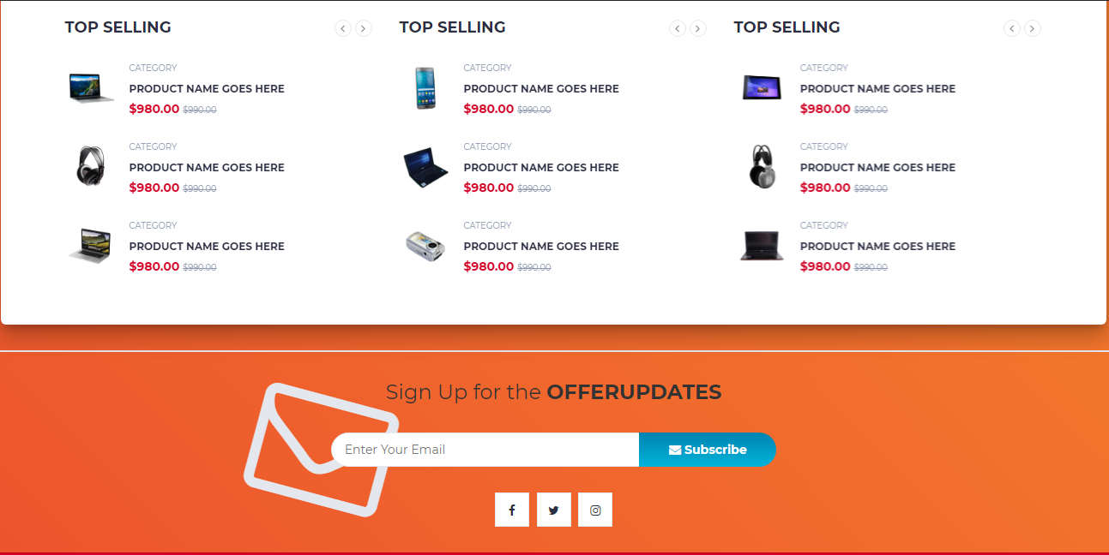
Home Page

Slide 9
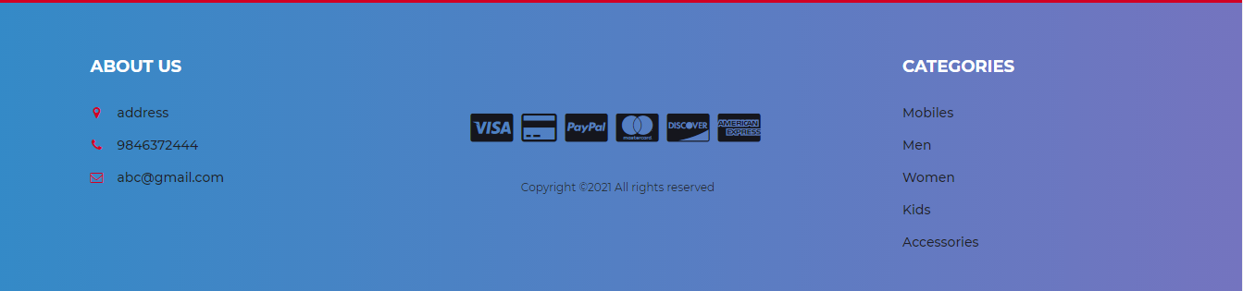
Home Page

Slide 10
Advantages
24/7 shopping
Saves time
Comparison shop
Price comparison
Consistency between advertised price and site price
Sometimes no cost delivery even to third party receiver
Ease in merchandise cancellation or return
Sometimes tracking of shipping available
Large online shopping site offering store comparison and sometimes no taxes

Slide 11
Disadvantages
Lack of touch and feel of merchandise
Lack of close quality examination
Unable to try the merchandise on
Delivery time
Shipping charges
Shipped returns
Security concerns
Privacy concerns
lack of personal attention from a salesman
More chances for mistakes in ordering the wrong item, slightly higher exposure of credit card security
Verification of credit card owner less rigorous

Slide 12
Requirements
HTML
CSS
JavaScript
JAVA
JSP
MySQL

Slide 13
Future Scope
There is enough scope for online business in the future if they understand shoppers psyche and cater to their needs.
Higher income driving the purchase of essential and nonessential products.
Evolving consumption patterns of Bangladeshi customers.
New technology and lifestyle trends creating replacement demand.

Slide 14
Conclusion
Today, the market place is flooded with several Online Shopping System options for shoppers to choose from. A variety of innovative products and services are being offered spoiling customers for choice. Online shopping is no more a privilege enjoyed by your friend and family living in the US or UK. Today, it is a reality in Bangladesh. In the last couple of years, the growth of Online Shopping System industry in Bangladesh has been phenomenal as more shoppers has started discovering the benefits of using this platform.

